Slide 1
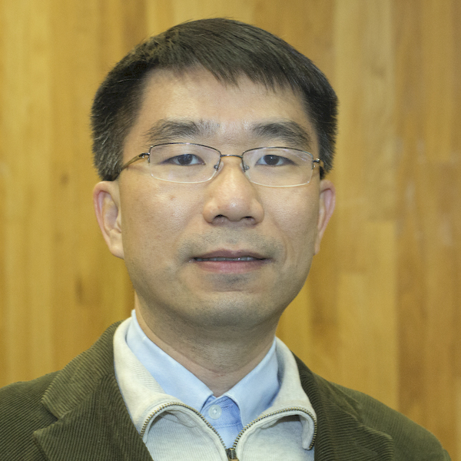

Data-driven Traffic Demand Models: Calibrating fundamental diagram of traffic flow and volume-delay functions from both speed and count data
Fang (Alicia) Tang (fangt@asu.edu)
Xuesong (Simon) Zhou (xzhou74@asu.edu)
School of Sustainable Engineering and the Built Environment
asu-trans-ai-lab (ASU Trans+AI Lab) (github.com)
Arizona State University
Prepared for 2022 Fall NCMUG Meeting
Monday, November 7, 2022

Slide 2
Outline
Introduction and Background
Fluid Queue and Polynomial Arrival Queue
Queue based volume-to-delay function (QVDF)
Case studies of Phoenix and NVTA
Open-source tools
Call for presentation

Slide 3
Learning Objectives
Understand how widely-used volume-delay BPR function can be interpreted from queueing analysis model, especially when demand > capacity
Understand opportunities of improving highway assignment modeling accuracy by using speed and count data in supply-side calibration
Calibrate fundamental diagram of traffic flow (capacity) and volume-delay parameters (alpha and beta) for different facility types
Open-source analysis tools to streamline and automate the calibration progress,
Case studies in North Virginia and Phoenix, AZ area and transferability in calibrating travel demand models in North Carolina
Note: This research is partially motivated by the excellent talk given by Dr. Leta Huntsinger and Dr. Nagui M Rouphail for North Carolina Model Users Group Meeting – April 2011. Title: Calibrating Travel Demand Model Volume-Delay Functions Using Bottleneck and Queuing Analysis

Slide 4
Introduction to volume-to-delay function
Standard static traffic assignment (STA): average travel time as a positive, nonlinear, and strictly increasing functions of volume-to-capacity ratio.
Basic parameters of a VDF:
  Free-flow travel time and the ultimate capacity of the link
  Other factors: distance, frequency of traffic signals, network knowledge, presence of tolls, safety, traffic information
Average vehicle delay: difference in travel time between vehicles unaffected and affected by the bottleneck
Queue formulation and dissipation in a bottleneck (M/D/n/FIFO )
  Random vehicles arrival at a bottleneck (M)
  Constant departure rate (D) in multiple lanes (n)
  First in-first out (FIFO) rule

Slide 5
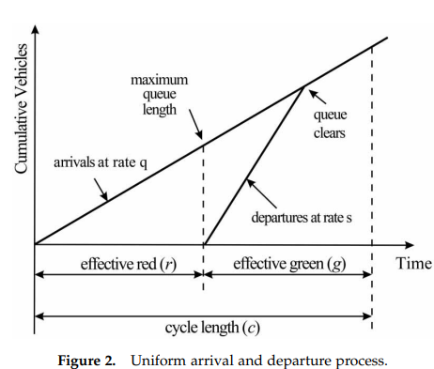
Evolution of delay estimation methods
Stage 1: steady-state queuing theory
  Deterministic arrival
  Binomial arrivals.
  Poisson arrivals
  General arrivals
Stage 2: time-dependent arrival rate
  Steady-state expressions for oversaturated conditions
Stage 3: New Horizon for Delay Estimation.
  Delay estimation for queue spillback and blocking conditions
  Artificial intelligence techniques for delay estimation
¹Cheng, C., Du, Y., Sun, L., & Ji, Y. (2016). Review on theoretical delay estimation model for signalized intersections. Transport Reviews, 36(4), 479-499.

Slide 6
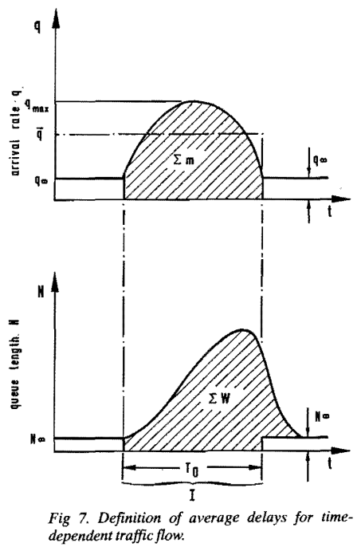
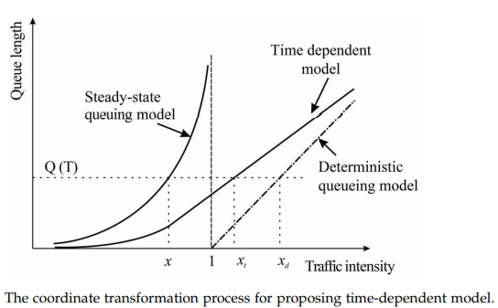
Evolution of delay estimation methods
¹Cheng, C., Du, Y., Sun, L., & Ji, Y. (2016). Review on theoretical delay estimation model for signalized intersections. Transport Reviews, 36(4), 479-499.

Slide 7


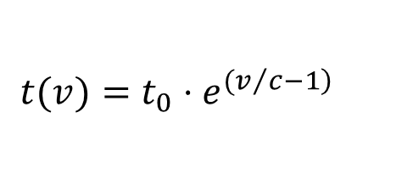
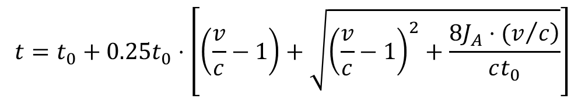
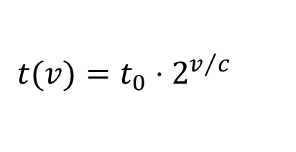
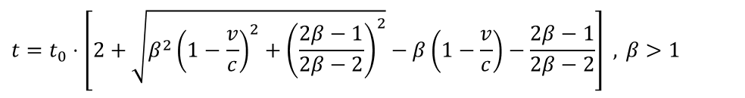
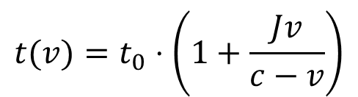
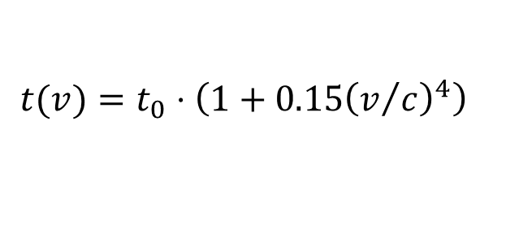
Evolution of delay estimation methods
Typical volume-delay function
  Chicago Area Transportation Study (1963):
  Smock (1963):
  BPR (1964):
  Davidson (1966):
  Spiess (1990):
  Akcelik (1991):
$$t(v)=t_{0}⋅2^{v/c}$$
$$t(v)=t_{0}⋅e^{{(v}/{\left.c−1\right)}}$$
$t_{0}:$free flow travel time
$v$: traffic volume
$c$: capacity
$J, JA, β$: parameters
$$t(v)=t_{0}⋅\left(1+0.15{\left(v/c\right)}^{4}\right)$$
$$t(v)=t_{0}⋅\left(1+\frac{Jv}{c−v}\right)$$
$$t=t_{0}⋅\left[2+\sqrt{β^{2}{\left(1−\frac{v}{c}\right)}^{2}+{\left(\frac{2β−1}{2β−2}\right)}^{2}}−β\left(1−\frac{v}{c}\right)−\frac{2β−1}{2β−2}\right] , β>1$$
$$t=t_{0}+0.25t_{0}⋅\left[\left(\frac{v}{c}−1\right)+\sqrt{{\left(\frac{v}{c}−1\right)}^{2}+\frac{\left.8J_{A}⋅(v/c\right)}{ct_{0}}}\right]$$

Slide 8
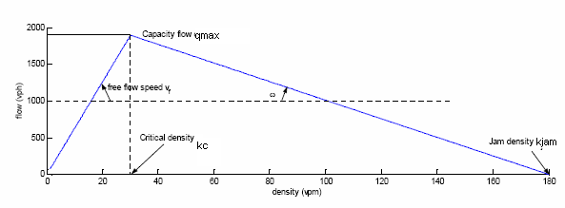
Limitations of Volume-Delay Function (VDF)
BPR volume-delay function
  Widely used in static traffic assignment
  Fail to capture queue evolution, building-up, propagation, dissipation
  Fail to represent a bottleneck with low flow but high travel time

Slide 9
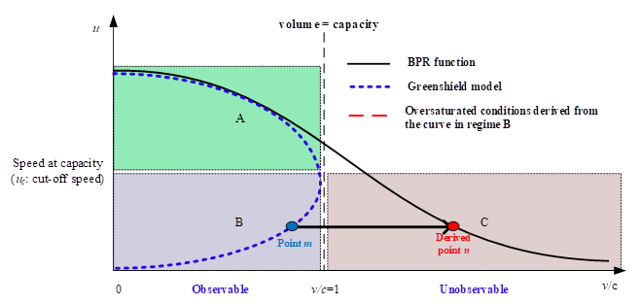
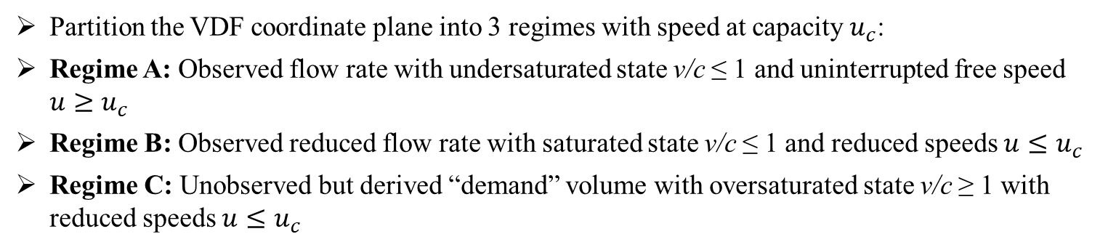
Calibration challenges
Partition the VDF coordinate plane into 3 regimes with speed at capacity $u_{c}$:
Regime A: Observed flow rate with undersaturated state v/c ≤ 1 and uninterrupted free speed $u≥u_{c}$
Regime B: Observed reduced flow rate with saturated state v/c ≤ 1 and reduced speeds $u≤u_{c}$
Regime C: Unobserved but derived “demand” volume with oversaturated state v/c ≥ 1 with reduced speeds $u≤u_{c}$
Three regimes in speed vs. v/c ratio coordinate plane
Mtoi, E. T., & Moses, R. (2014). Calibration and evaluation of link congestion functions: applying intrinsic sensitivity of link speed as a practical consideration to heterogeneous facility types within urban network. Journal of Transportation Technologies.

Slide 10
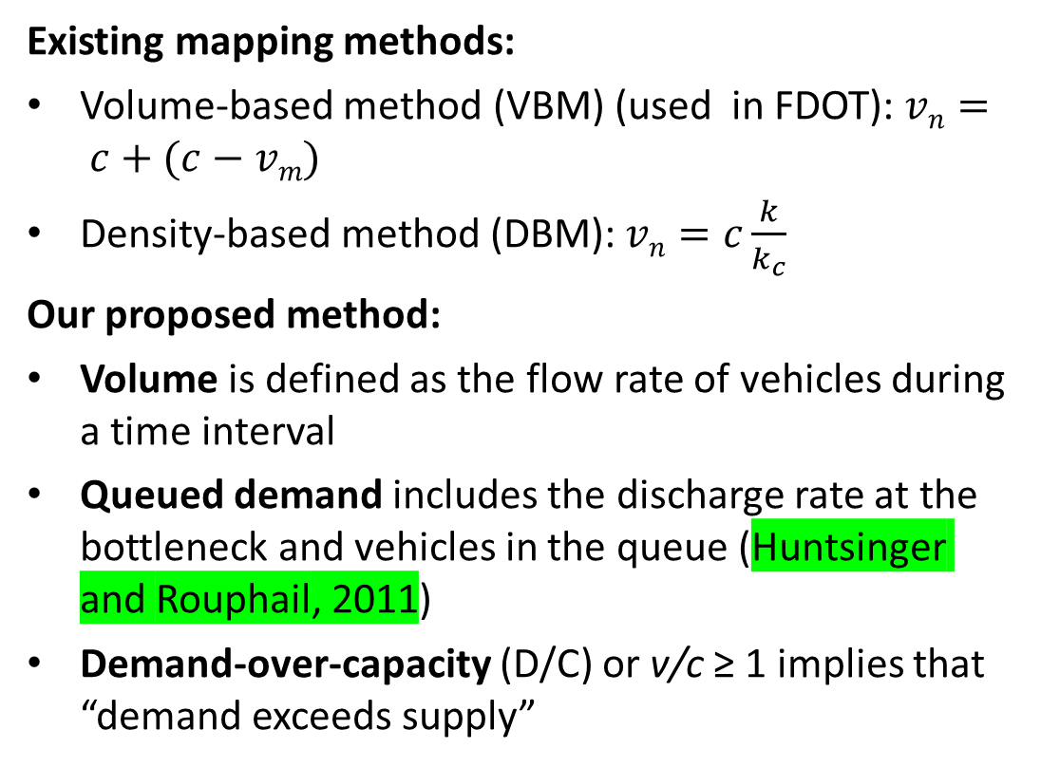
How to Define Congestion and (Queued) Demand?
Existing mapping methods:
Volume-based method (VBM) (used in FDOT): $vn= c+(c−vm)$
Density-based method (DBM): $vn=c\frac{k}{k_{c}}$
Our proposed method:
Volume is defined as the flow rate of vehicles during a time interval
Queued demand includes the discharge rate at the bottleneck and vehicles in the queue (Huntsinger and Rouphail, 2011)
Demand-over-capacity (D/C) or v/c ≥ 1 implies that “demand exceeds supply”
Three regimes in speed vs. v/c ratio coordinate plane
Mtoi, E. T., & Moses, R. (2014). Calibration and evaluation of link congestion functions: applying intrinsic sensitivity of link speed as a practical consideration to heterogeneous facility types within urban network. Journal of Transportation Technologies.

Slide 11
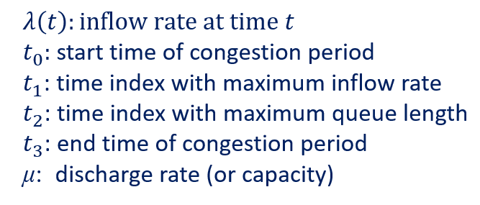
Newell’s fluid polynomial queueing model with quadratic arrival rates
$$λ\left(t\right)=λ\left(t_{1}\right)−ρ{(t−t_{1})}^{2}$$
Closed-form solution of delays
Key Parameters:

Slide 12
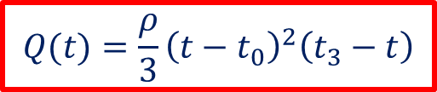
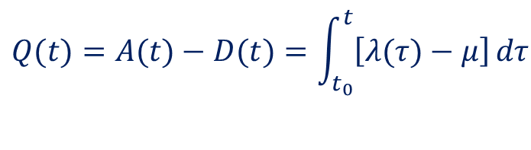
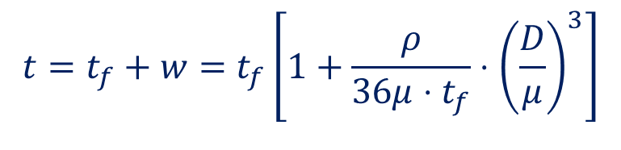

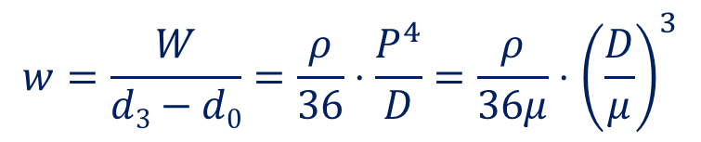
Newell’s fluid polynomial queueing model with quadratic arrival rates
$$λ\left(t\right)=λ\left(t_{1}\right)−ρ{(t−t_{1})}^{2}$$
Queue length:
$$\begin{matrix}Q(t)=A(t)−D(t)=\int_{t_{0}}^{t}{\left[λ(τ)−μ\right]}dτ \\ \\ \end{matrix}$$
$$Q(t)=\frac{ρ}{3}{\left(t−t_{0}\right)}^{2}\left(t_{3}−t\right)$$
Average travel time function:
$$t=t_{f}+w=t_{f}\left[1+\frac{ρ}{36μ⋅t_{f}}⋅{\left(\frac{D}{μ}\right)}^{3}\right]$$
Average delay:
$$w=\frac{W}{d3−d0}=\frac{ρ}{36}⋅\frac{P^{4}}{D}=\frac{ρ}{36μ}⋅{\left(\frac{D}{μ}\right)}^{3}$$
$$μ=\frac{\text{d}\text{3}\text{−}d_{0}}{t_{3}−t_{0}}=\frac{D}{P}$$

Slide 13
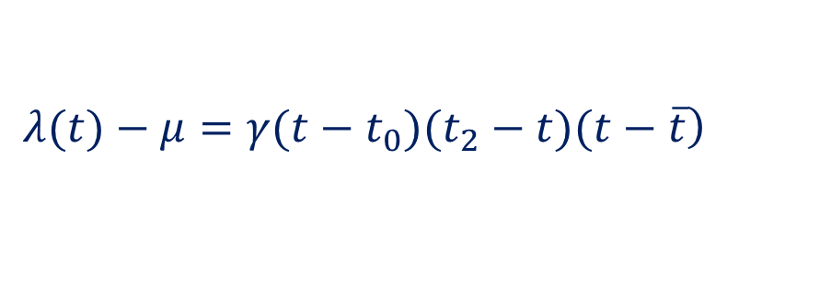



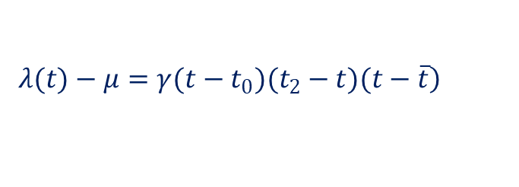


Fluid polynomial queueing model with cubic arrival rates
Cubic form:
$$λ(t)=λ(t_{1})−γ_{1}{\left(t−t_{1}\right)}^{2}−γ_{2}{\left(t−t_{1}\right)}^{3}$$
Factored form of :
$$λ(t)−μ$$
$$\left.λ(t)−μ=γ(t−t_{0})(t_{2}−t)(t−\overline{t}\right)$$
Inflow rate should satisfy the following conditions:
  when
  when
  the change of inflow rate at time t₀ should not be very large
$$λ(t)>μ$$
$$t_{0}<t<t_{2}$$
$$λ(t)<μ$$
$$t_{2}<t<t_{3}$$
Cheng, Qixiu, Zhiyuan Liu, Jifu Guo, Xin Wu, Ram Pendyala, Baloka Belezamo, and Xuesong Simon Zhou. "Estimating key traffic state parameters through parsimonious spatial queue models." Transportation Research Part C: Emerging Technologies 137 (2022): 103596.

Slide 14
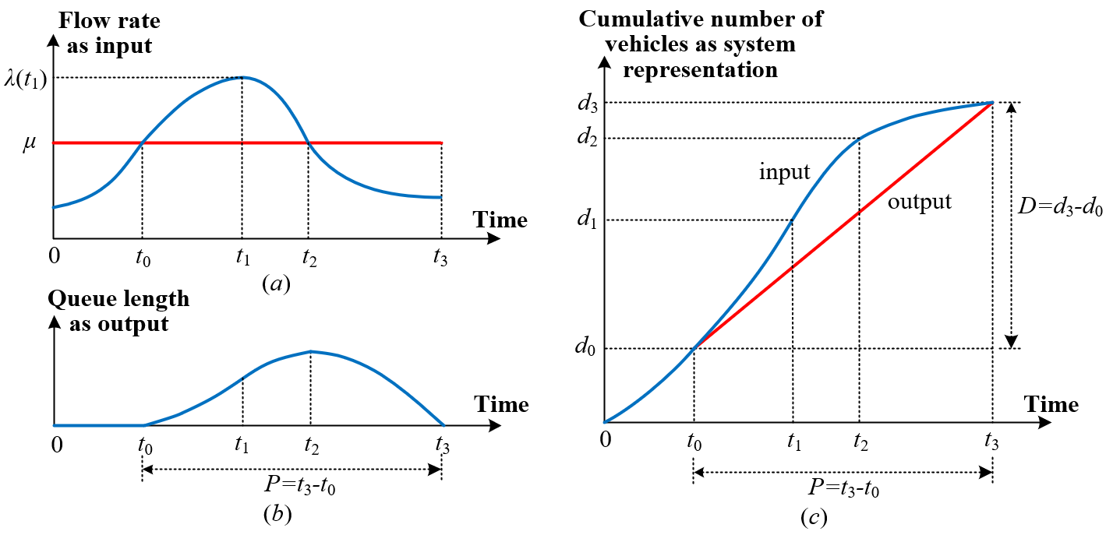
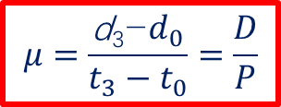

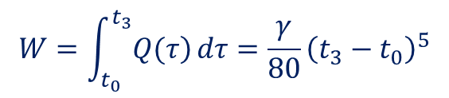
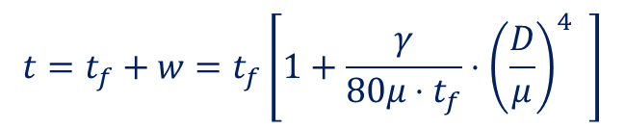
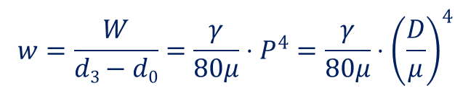
Fluid polynomial queueing model with cubic arrival rates
Cubic form:
Total delay: W
$$W=\int_{t_{0}}^{t_{3}}{\left.Q(τ\right)}dτ=\frac{γ}{80}{\left(t_{3}−t_{0}\right)}^{5}$$
Average delay:
$$w=\frac{W}{d3−d0}=\frac{γ}{80μ}⋅P^{4}=\frac{γ}{80μ}⋅{\left(\frac{D}{μ}\right)}^{4}$$
$$μ=\frac{\text{d}\text{3}\text{−}d_{0}}{t_{3}−t_{0}}=\frac{D}{P}$$
Average travel time function:
$$t=t_{f}+w=t_{f}\left[1+\frac{γ}{80μ⋅t_{f}}⋅{\left(\frac{D}{μ}\right)}^{4} \right]$$
  Only two parameters: $γ,μ$

Slide 15
Queue based volume-to-delay function (QVDF)
Basic concepts
  Volume-to-capacity (V/C) ratio vs. inflow demand-to-capacity (D/C) ratio
  Congestion duration, cut-off-speed, and average discharge rate
Linking (single period) Polynomial Arrival Queue with Macroscopic Volume-Delay Function Over Multiple Days
Introduction to MRM.
MRM terminology, definitions, and tools.
MRM literature and outreach findings.

Slide 16


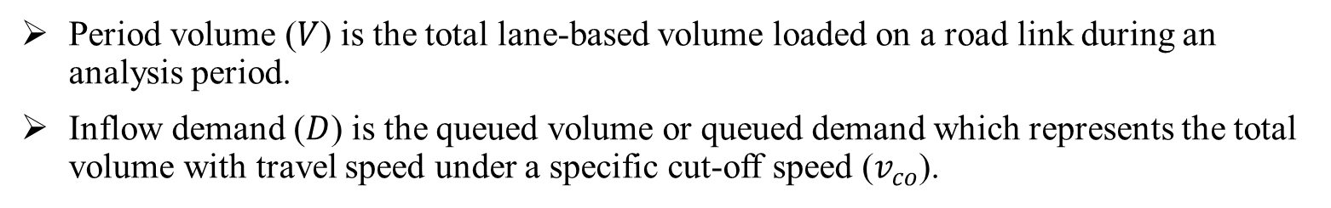
Basic concepts
Period volume ($V$) is the total lane-based volume loaded on a road link during an analysis period.
Inflow demand ($D$) is the queued volume or queued demand which represents the total volume with travel speed under a specific cut-off speed ($v_{co}$).

Slide 17
Basic concepts
PAQ models, congestion duration $P:$the peak period from $t_{0}$ to $t_{3}$ (i.e., $P=t_{3}−t_{0}$), where arrival rate $λ(t)$ is higher than the average discharge rate $μ$.
The relationship among time-dependent speed, arrival rates, cut-off speed, and average discharge rate

Slide 18
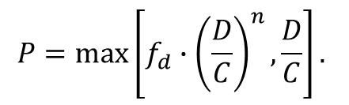
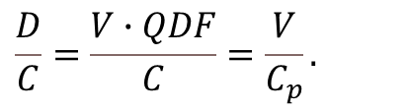



Linking Polynomial Arrival Queue with Macroscopic Volume-Delay Function
Major steps towards queue-oriented link performance function QVDF:
$$\frac{D}{C}=\frac{V∙QDF}{C}=\frac{V}{C_{p}}.$$
$$P=\max\left[{f_{d}∙\left(\frac{D}{C}\right)}^{n},\frac{D}{C}\right].$$
$$μ=\frac{C}{{f_{d}\left(\frac{D}{C}\right)}^{n−1}}$$
$$w_{t_{2}}=\frac{L}{v_{t_{2}}}−\frac{L}{v_{co}}=\frac{L}{v_{co}}∙\left(\frac{v_{co}−v_{t_{2}}}{v_{t_{2}}}\right)=\frac{L}{v_{co}}∙MSR=\frac{L}{v_{co}}{∙f_{p}∙\left(P\right)}^{s}$$
$$γ=64μ∙\frac{L}{v_{co}}∙{f_{p}\left(P\right)}^{s−4}$$
$$v\left(t\right)=\frac{L}{\frac{L}{v_{co}}+w(t)}$$
$$w(t)=\frac{γ}{4μ}{\left(t−t_{0}\right)}^{2}∙{\left(t−t_{3}\right)}^{2}$$

Slide 19


Step 0: Fundamental Diagram: Our proposed s-shaped three-parameter (S3) traffic stream model
Calibration method: a recent 3-parameter model (S3 model) by Cheng et al., (2021)
Input: observed speed and density
speed-density relationship
Output: free-flow speed, critical density, shape parameter
v: speed
k: density
vf: free-flow speed
kc: critical density
m: shape parameter
Output: ultimate capacity
Example of calibrated speed-volume curve using S3 model
19
An s-shaped three-parameter (S3) traffic stream model with consistent car following relationship
Qixiu (Kevin)Cheng, Zhiyuan Liu , Yuqian Lin, Xuesong (Simon) Zhou , TR Part B, 2021

Slide 20
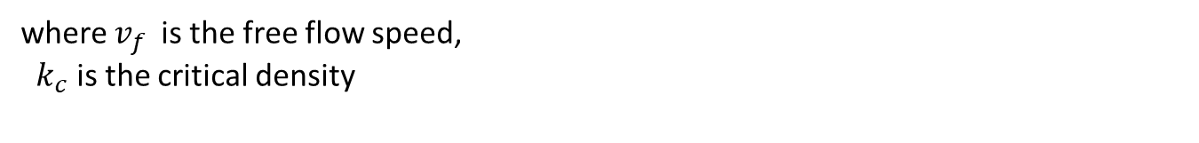
Step 0: Fundamental Diagram: Our proposed s-shaped three-parameter (S3) traffic stream model
Projections to the 2D planes:
where $v_{f}$ is the free flow speed,
$k_{c}$ is the critical density
m=maximal flow inertial coefficient
20
An s-shaped three-parameter (S3) traffic stream model with consistent car following relationship
Qixiu (Kevin)Cheng ª, Zhiyuan Liu ª, Yuqian Lin ª, Xuesong (Simon) Zhou ^{b}

Slide 21
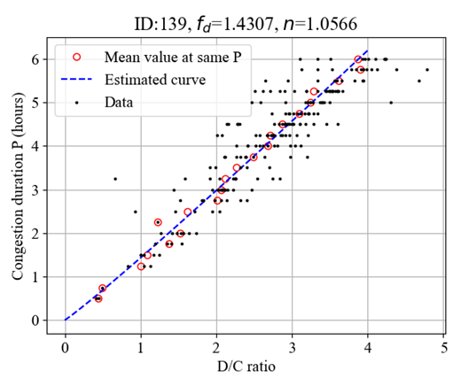
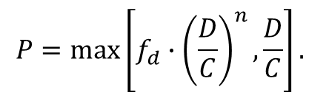
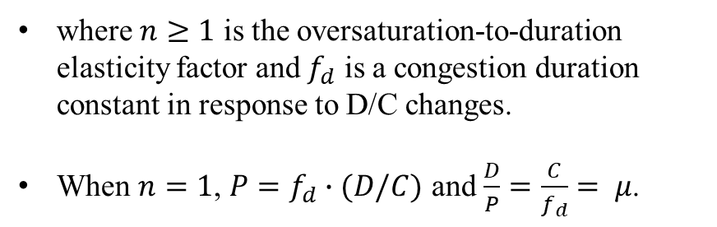
Step 1: Linking Polynomial Arrival Queue with Macroscopic Volume-Delay Function (with D/C over Observations from Multiple Days)
Assumption: power function between congestion duration $P$ and traffic intensity in terms of the D/C ratio.
The average discharge rate should be less than the capacity, i.e., $μ≤C$. To ensure the capacity constraint, the following condition should be satisfied: $D/C≤P$
$$P=\max\left[{f_{d}∙\left(\frac{D}{C}\right)}^{n},\frac{D}{C}\right].$$
where $n≥1$ is the oversaturation-to-duration elasticity factor and $f_{d}$ is a congestion duration constant in response to D/C changes.
When $n=1$, $P=f_{d}∙(D/C)$ and $\frac{D}{P}=\frac{C}{f_{d}}= μ$.
Zhou Simon, Xuesong, Qixiu Cheng, Xin Wu, Peiheng Li, Baloka Belezamo, Jiawei Lu, and Mohammad Abbasi. 2022. "A meso-to-macro cross-resolution performance approach for connecting polynomial arrival queue model to volume-delay function with inflow demand-to-capacity ratio." Multimodal Transportation 1 (2):100017

Slide 22
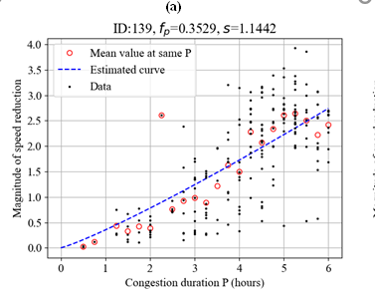



Step 2: Linking Polynomial Arrival Queue with Macroscopic Volume-Delay Function (with MSR from Observations from Multiple Days)
$$MSR=\frac{v_{co}−v_{t_{2}}}{v_{t_{2}}}$$
The magnitude of speed reduction (MSR):
We further establish a relationship between congestion duration $P$ and $MSR$
$$MSR={f_{p}∙\left(P\right)}^{s}$$
Where $s≥1$ is the duration-to-speed reduction elasticity factor and $f_{p}$ is an MSR reduction constant in response to changes of congestion duration.
The boundary condition is satisfied for $MSR=0$ as $P=0$ and $v_{t_{2}}=v_{co}$. When $P=1$, $f_{p}$ represents the baseline value for speed reduction magnitude, $\frac{v_{t_{2}}}{v_{co}}$ $=\frac{1}{1+f_{p}}$.

Slide 23
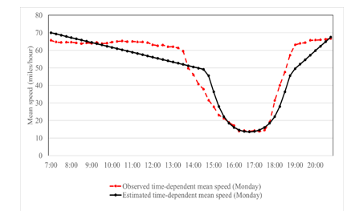



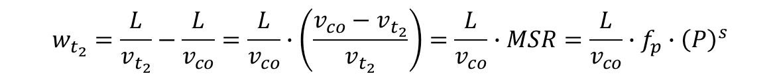
Step 3: Linking Polynomial Arrival Queue with Macroscopic Volume-Delay Function
we create a connection between $w_{t_{2}}$(i.e., the longest delay at $t_{2}$ compared with $v_{co}$) and P
$$w_{t_{2}}=\frac{L}{v_{t_{2}}}−\frac{L}{v_{co}}=\frac{L}{v_{co}}∙\left(\frac{v_{co}−v_{t_{2}}}{v_{t_{2}}}\right)=\frac{L}{v_{co}}∙MSR=\frac{L}{v_{co}}{∙f_{p}∙\left(P\right)}^{s}$$
Time-dependent speed can be derived as follows:
time-dependent queue
time-dependent speed
time-dependent delay

Slide 24

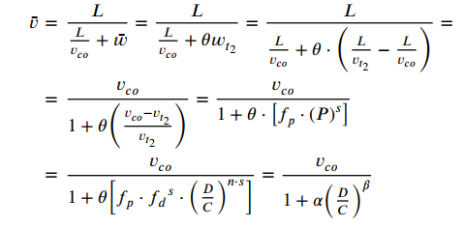


Step 4: Linking Polynomial Arrival Queue with Macroscopic Volume-Delay Function
Generate average delay
Generate average speed
Generate largest delay
Transition ratio

Slide 25
A case study of Phoenix
Case study 1: Individual locations along a freeway corridor in Phoenix, Arizona
  7:00-21:00 as one analysis period
Phoenix I-10 freeway corridor and the four detectors

Slide 26
Results
Volume-speed scatters of entire year’s data (from 7:00 to 21:00 ) and calibrated traffic flow model

Slide 27
Results
Calibration results of step 2 calibration that links congestion duration to the magnitude of speed reduction

Slide 28
Results
Curves between D/C ratio and average speed during congestion duration

Slide 29
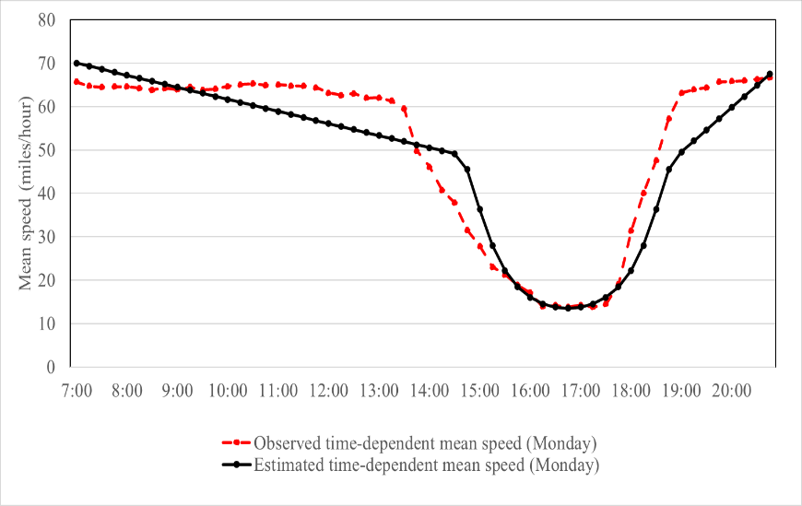
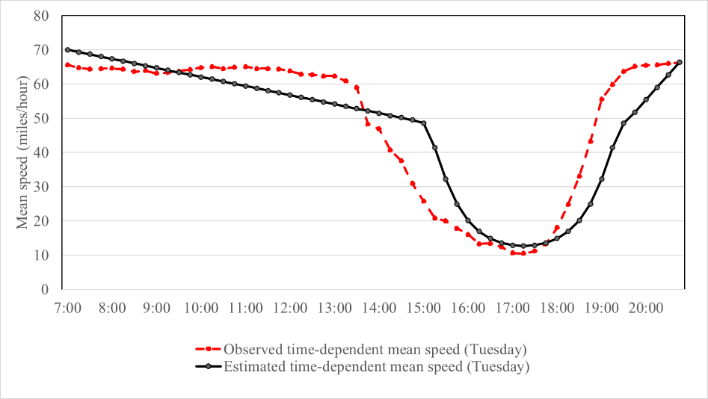

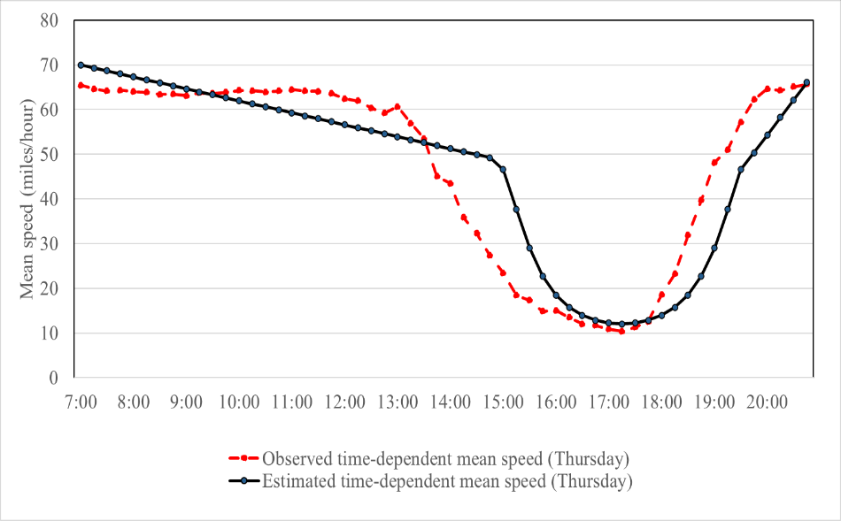
Results
Observed time-dependent mean speed and estimated speed at detector ID 87 on Monday
Observed time-dependent mean speed and estimated speed at detector ID 87 on Tuesday
Observed time-dependent mean speed and estimated speed at detector ID 87 on Wednesday
Observed time-dependent mean speed and estimated speed at location with detector ID 87 on Thursday

Slide 30
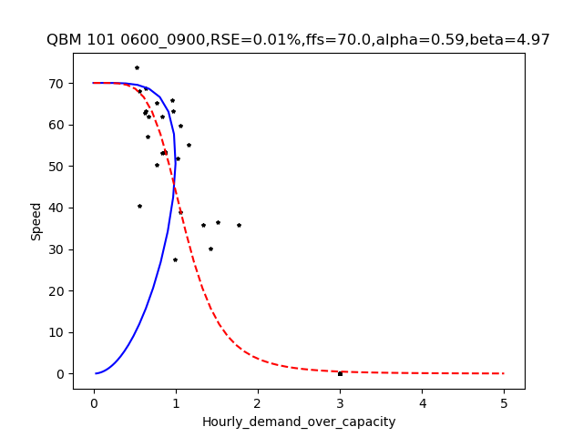
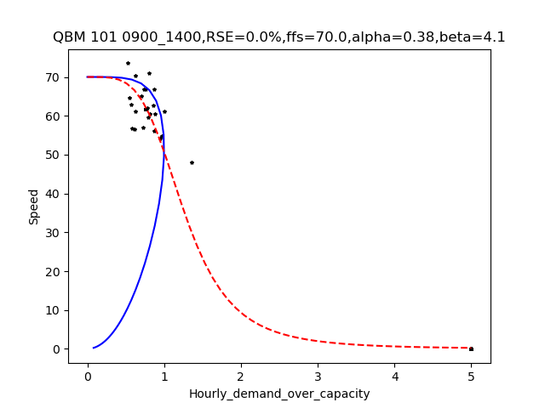
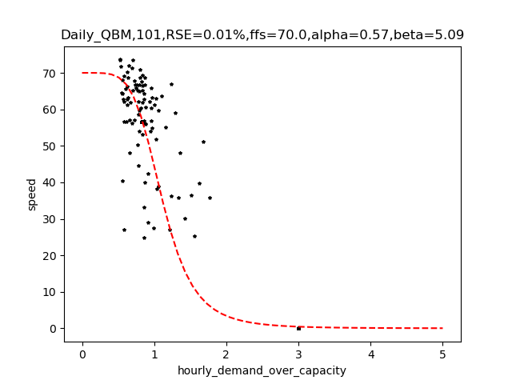
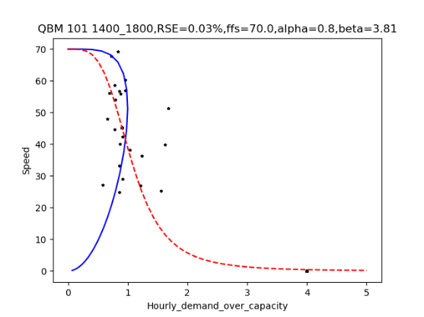
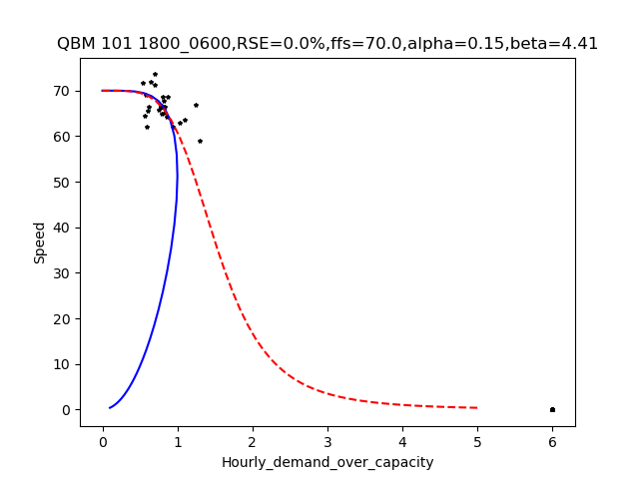
Discussion: Limitation and Calibration challenges
Period-based and day-based calibration
Hourly v/c vs. speed

Slide 31


Case study 2: Congestion Bottleneck Identification
North Virginia Priority Corridors
11 Priority Corridors and 20 Corridor Segments
 | Priority Corridors/Segments
1 | I395
2 | I495
3 | I66
4 | I95
5 | RT7
6 | US1
7 | US15
8 | US29
9 | US50Inner
10 | US50Outer
11 | VA234
12 | VA244
13 | VA267
14 | VA28
15 | VA286
16 | VA294
17 | VA607
18 | VA620
19 | VA659
20 | VA9
Joint work by Cambridge Systematics, Inc. and Arizona State University
Details can be found at
TRB conference paper: 23-05182
Integrated analytical and simulation based DTA to address scalability in regional planning applications, Mohammad Abbasi (ASU), Feng Liu (CS), Xuesong Zhou (ASU)

Slide 32


Map Matching for INRIX Data
TMC locations distributed onto the network
Map matching results of I-395 East corridor
TMC locations
Matched links and route on transportation planning network
Prepared by Cambridge Systematics, Inc. and Arizona State University

Slide 33

Map Matching for INRIX Data
Map matching on general-purpose lanes and HOV lane (I-395 East)
TMC locations
Matched links and route on transportation network
Prepared by Cambridge Systematics, Inc. and Arizona State University

Slide 34

Congestion Bottleneck Identification (CBI)
Corridor Filter
Visualization for
Traffic States and Bottlenecks
Aggregation Panel
Parameters of
Bottleneck Detection
Congestion and Bottleneck Identification (CBI) Tool Software Download | FHWA (dot.gov)
Prepared by Cambridge Systematics, Inc. and Arizona State University

Slide 35

Corridor-level Congestion Identification
Average speed and congestion duration
Corridors | Avg Speed AM_ | Avg Speed PM | Avg Congestion Duration AM | Avg Congestion Duration PM | Avg Speed (AM+PM) | Avg Congestion Duration (h)
I395__E | 30.21 | 50.22 | 2.70 | 0.79 | 40.22 | 1.75
I395__W | 56.62 | 30.17 | 0.00 | 2.40 | 43.39 | 1.20
I395_Express__E | 60.93 | 56.56 | 0.18 | 0.33 | 58.74 | 0.25
I395_Express__W | 59.43 | 61.29 | 0.00 | 0.12 | 60.36 | 0.06
I495__E | 57.90 | 36.34 | 0.29 | 2.74 | 47.12 | 1.52
I495__E_N | 47.75 | 50.11 | 1.40 | 1.17 | 48.93 | 1.29
I495__W | 59.06 | 56.19 | 0.20 | 0.25 | 57.63 | 0.23
I495__W_S | 61.62 | 35.06 | 0.11 | 3.24 | 48.34 | 1.68
I495_Express__E | 63.65 | 19.61 | 0.00 | 4.85 | 41.63 | 2.42
I495_Express__E_N | 66.75 | 68.09 | 0.00 | 0.00 | 67.42 | 0.00
I495_Express__W | 59.87 | 48.99 | 0.00 | 1.21 | 54.43 | 0.60
I495_Express__W_S | 67.39 | 62.55 | 0.00 | 0.02 | 64.97 | 0.01
I66_I-66 Inside Beltway_E | 53.42 | 39.01 | 0.59 | 2.29 | 46.22 | 1.44
I66_I-66 Inside Beltway_W | 56.57 | 56.96 | 0.33 | 0.33 | 56.77 | 0.33
I66_I-66 outside Beltway_E | 44.23 | 63.15 | 1.94 | 0.04 | 53.69 | 0.99
I66_I-66 outside Beltway_W | 64.93 | 45.08 | 0.00 | 2.20 | 55.01 | 1.10
I95__N | 45.95 | 63.86 | 1.36 | 0.00 | 54.90 | 0.68
I95__S | 66.89 | 49.20 | 0.00 | 1.43 | 58.04 | 0.71
I95_Express__N | 69.00 | 55.67 | 0.10 | 0.72 | 62.33 | 0.41
I95_Express__S | 64.59 | 70.97 | 0.00 | 0.00 | 67.78 | 0.00
Definition of congestion duration
depends on 3 key parameters in QKV curve
$v_{f}$ : free-flow speed
$v_{c}$ : critical speed (speed at capacity)
Cap: Ultimate capacity
Unit of Avg Speed: miles per hour
Unit of Congestion Duration: hour
Prepared by Cambridge Systematics, Inc. and Arizona State University

Slide 36

Link- and Corridor-Level Analytical VDF Model Validation
Period: 6am-8pm Observed Weekday Speed vs. DTALite Model Speed
I-395 East Direction
Prepared by Cambridge Systematics, Inc. and Arizona State University

Slide 37




Link- and Corridor-Level Validation
I-395 N Direction
Prepared by Cambridge Systematics, Inc. and Arizona State University

Slide 38




Future Research topics: Peak Load Factor (PLF)
Definition
$$PLF=\frac{Average hourly volume in the given period}{Maximun hourly volume}=\frac{\overline{v_{period}}}{v_{max}}=\frac{v_{period}}{The number of hours∗v_{max}}$$
Where,
$v_{period}$: The total volume of the peak period
$\overline{v_{period}}$: $Average hourly volume of a period$
$v_{max}$: $Peak hour volume$
$t_{0}^{′}$: $t_{1}−0.5$ hours
$t_{1}^{′}$: time index with maximum inflow rate which equals to $t_{1}$
$t_{2}^{′}$: $t_{1}+0.5$ hours
$μ^{′}$: reference discharge rate which equals to $λ\left(t_{0}^{′}\right)$
$v_{max}$=$\int_{t_{0}^{′}}^{t_{2}^{′}}{λ\left(t\right)}dt$

Slide 39
Final words: GMNS
The objective of the General Modeling Network Specification (GMNS) is to provide a common human and machine-readable format for sharing routable road network files.
  It is designed to be used in multi-resolution and multi-modal static and dynamic transportation planning and operations models.
  It will facilitate the sharing of tools and data sources by modelers.
github.com/zephyr-data-specs/GMNS
39

Slide 40

GMNS
The project is overseen by a project management group, with MPO, city, industry, academic and US DOT participation. In 2019, with support from the Federal Highway Administration, the team developed requirements and an initial release of the specification.
github.com/zephyr-data-specs/GMNS
40

Slide 41

Open-source tools: GTFS2GMNS
General Transit Feed Specification (GTFS) is a data specification that allows public transit agencies to publish their transit data.
GTFS2GMNS is an open-source Python code that enables users to conveniently construct any multi-modal transit network in GMNS format from GTFS. https://github.com/asu-trans-ai-lab/GTFS2GMNS
Developers: Fang (Alicia) Tang (PhD student, ASU), Xianting (Alice) Huang (MS student, CMU)
link type code | link type name | definition
0 | Access/egress links | Links from activity zones to bus/metro or commuter rail stations
1 | Boarding/deboarding links | Links connecting stations to stops of directed routes
2 | Service links | The links representing the planning of each route
3 | Transferring links | Transferring links between different stations/stops
41

Slide 42

Open-source tools: GTFS2GMNS
The data flow structure of converting GTFS to GMNS
Input
The input files of GTFS can be downloaded from the GTFS download website, including
routes.txt
trips.txt
stops.txt
stop_times.txt
The definition of the above files can be referenced here.
Output
Multi-modal transit network with GMNS format
node.csv
link.csv
42

Slide 43

Open-source tools: GTFS2GMNS
Washington Metropolitan Area Transit Authority (WMATA)
DC Circulator
DC Streetcar
Arlington Transit: ART,VA
Dash| Alexandria, VA
CUE Bus| Fairfax, VA
Fairfax Connector, VA
Potomac and Rappahannock Transportation Commission,VA
Loudoun County Transit, VA
Virginia Railway Express, VA
Amtrak
Transportation | Annapolis, MD
Transportation | Prince George's County,MD
Public Transportation | Calvert County, MD
Ride on | Montgomery, MD
TransIT | Frederick County, MD
Maryland Transit Administration
Carroll Transit System|Carroll County, MD
RTA of Central Maryland
VanGO | Charles County, MD
43

Slide 44


Slide 45



Takeaway Messages:
Challenges in calibrating Bureau of Public Roads (BPR) function:
Lack of rigorous definitions for the volume-to-capacity (v/c) ratio
$$u=\frac{u_{f}}{1+α{\left(\frac{v}{c}\right)}^{β}}$$
What is the meaning of the “capacity” is in the v/c ratio?
What is the meaning of the v/c ratio in the BPR function?
What is the relation between the v/c and peak hour factors (PHFs)?
v/c ≥ 1
v/c ≥ 1 might not be empirically observed

Slide 46
Call for Presentations
Deadline: November 18, 2022
Conference Sponsoring Committees
Standing Committee on Transportation Planning Analysis & Application (AEP15)
Standing Committee on Travel Behavior & Values (AEP30)
Standing Committee on Transportation Network Modeling (AEP40)
Standing Committee on Transportation Demand Forecasting (AEP50)

